Slide 1
A Heuristic Model to Solve Constraint Satisfaction Problem
Ryan Darras
Sudhanshu Semwal
Yanyan Zhuang
Tim Chamillard

Slide 2
Background
Constraint Satisfaction Problem (CSP)
Set of objects, set of constraints on objects
Solved state = every constraint is satisfied
High complexity
Requires heuristics and search algorithms
Heuristic
Improves algorithm performance
Not guaranteed to get optimal solution

Slide 3
Significance
CSPs are everywhere
Traveling Salesman Problem (TSP)
Job Shop Scheduling Problem (JSP)
Graph Coloring Problem (GCP)
Heuristics aren’t perfect
Song [1] looks at how to modify existing heuristics to be risk-resilient
Claim their results are effective, but not perfect

Slide 4
Limitations
Quality of testing applicants
Do we have a diverse enough set?
Quantity of testing applicants
Enough for a few sub groups?
Unrealistic to handle every CSP
Study a subset of diverse & popular CSPs

Slide 5
Purpose
To create a successful model for creating heuristics for CSPs.
We hypothesize that students using this model will produce more efficient heuristics while maintaining minimal error in accuracy.

Slide 6
How
Create simulation with state of the art algorithms to compare against.
Genetic algorithm to study which variables of system are most/least significant.
Develop & test model iteratively.
Start with one CSP, then apply to another.
Test with applicants.

Slide 7
Targeted CSPs
Traveling Salesman Problem
n Queens Problem
Graph Coloring Problem

Slide 8
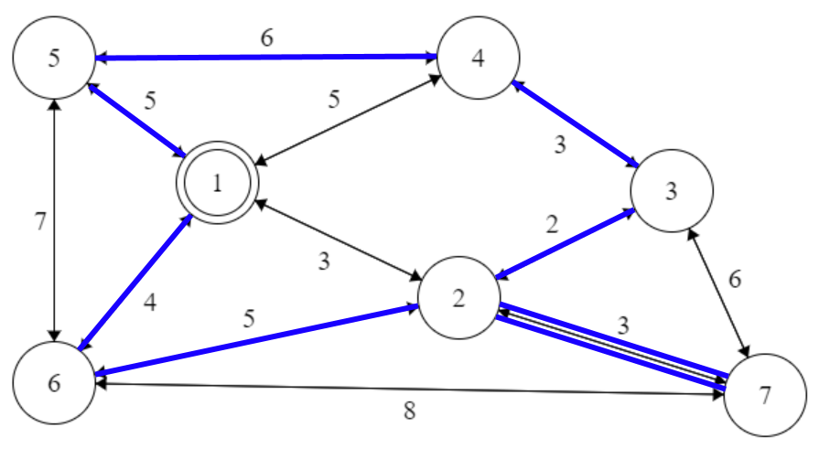
Traveling Salesman Problem
Heuristic Variables
Willingness to Backtrack
Determine bad path
Clustering
Algorithms
Bektas [2]
Notes:
Determine bad path – How far do we have to go while only visiting a certain amount of nodes before we have determined this was a bad route to take vs others?
Clustering – Organizing nodes in clusters like cities to optimize search

Slide 9
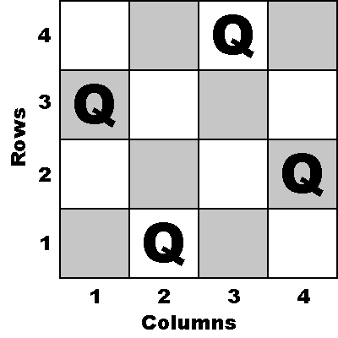
n Queens Problem
Heuristic Variables
Overlap
Nullification
Algorithms
Bell & Stevens [3]
Notes:
Overlap – How many nodes did I just nullify that were already nullified?
Nullification – How many nodes did I just nullify?

Slide 10
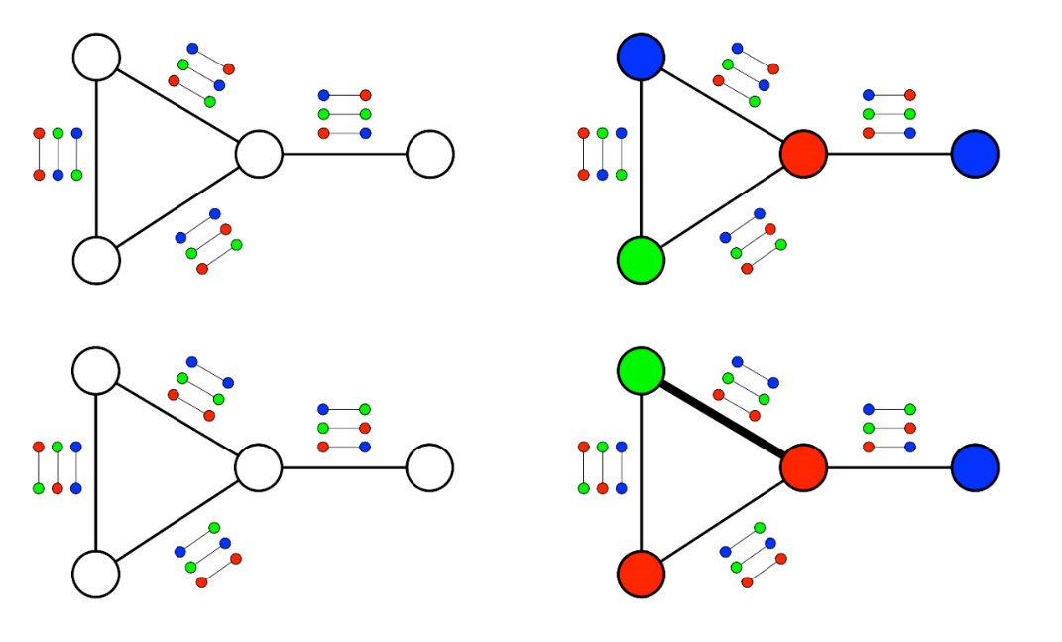
Graph Coloring Problem
Heuristic Variables
Color acceptance ranking
Node vulnerabilities
Algorithms
Moalic & Gondran [4]
Notes:
Color acceptance ranking – How many options does the given color have to be satisfied.
Node vulnerabilities – When do we consider a node to be vulnerable, and how do we handle that.

Slide 11
Evaluation Metrics
Time Complexity
seconds
Space complexity
# vertices
Accuracy
percentage of optimal
Ease of use
Estimation of model effectiveness for user

Slide 12
Goals and Conclusions
Create an easy to use model for generating heuristics for CSPs.
Collect variable data when solving these problems to determine which variables have the biggest impact.
Deliver comprehensive and expandable model.

Slide 13
References
[1] S. Song, Kai Hwang and Yu-Kwong Kwok, "Risk-resilient heuristics and genetic algorithms for security-assured grid job scheduling," in IEEE Transactions on Computers, vol. 55, no. 6, pp. 703-719, June 2006. doi: 10.1109/TC.2006.89
[2] T. Bektas, “The multiple traveling salesman problem: an overview of formulations and solution procedures,” Omega, vol. 34, no. 3, pp. 209– 219, 2006.
[3] J. Bell and B. Stevens, “A survey of known results and research areas for n-queens,” Discrete Mathematics, vol. 309, no. 1, pp. 1–31, 2009.
[4] Laurent Moalic and Alexandre Gondran. 2017. Heuristic rope team: a parallel algorithm for graph coloring. In Proceedings of the Genetic and Evolutionary Computation Conference (GECCO '17). ACM, New York, NY, USA, 314-320. DOI: https://doi.org/10.1145/3071178.3071291

